Slide 1
An Awana Profile Management Site for users and churches.
Notes:
MyAwana currently is a site to help simplify profile management for users and churches. Your account for MyAwana is the same as awana.org, so you can use the same login credentials for both. All data on MyAwana plugs back into Salesforce and is connected to awana.org.

Slide 2
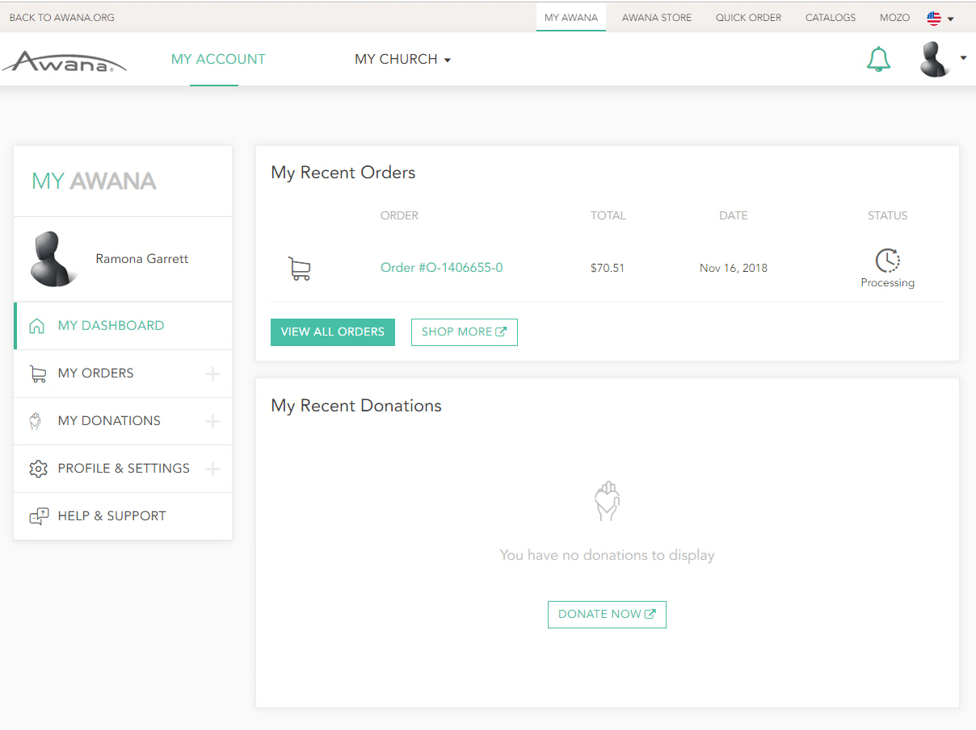
Notes:
When a user logs in, they will get to see this main screen displaying their recent personal order and donation history, called “My Dashboard”. This is a way for us to get users immediate tracking and donation information, which links back directly to their order/donation record on the store. They can also view all order history on the “My Orders” tabs and all donation history on the “My Donations” tabs on the left sidebar menu.

Slide 3
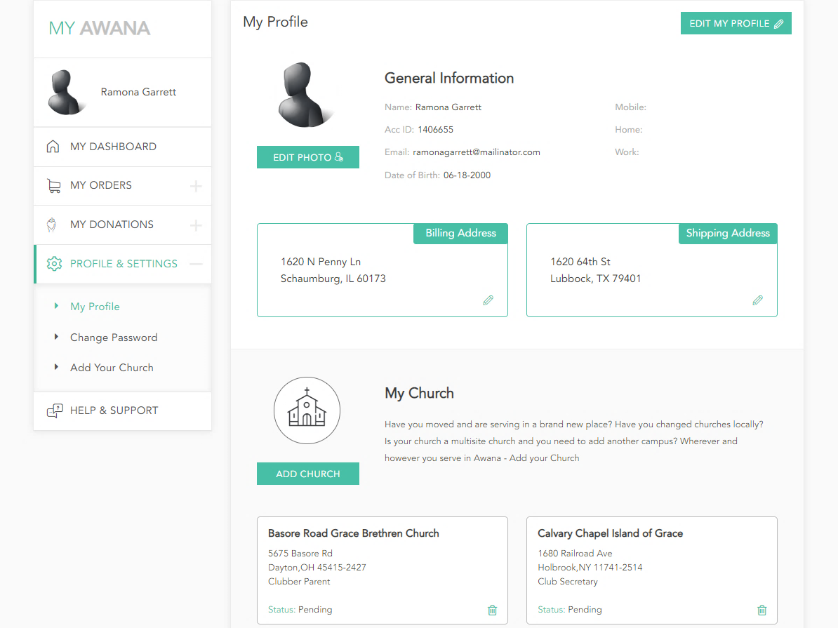
Notes:
On the “My Profile” page, a user can also edit their general profile information, such as addresses, passwords, profile pictures, etc. All of this information is directly connected to their Salesforce account.

Slide 4
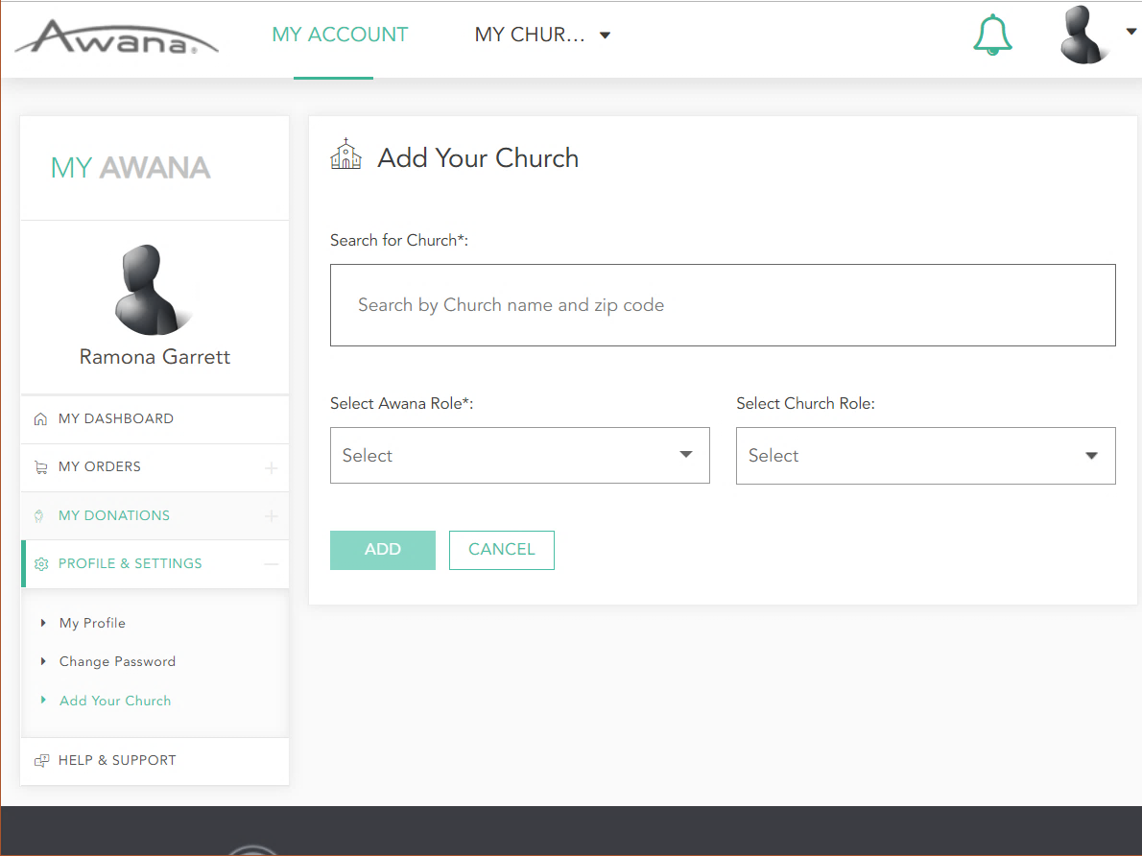
Notes:
A user also has the ability to request to be added to a church through MyAwana. On the "Add Your Church" tab, you can search for your church by name or zipcode. Once you have selected your church and your Awana Role (i.e. Commander, Puggles Leader, etc.) and submitted, it will send an email and notification of your request to your church's organization owners (aka the Commander and any other leaders handling your church's Awana account).

Slide 5
Notes:
Now, once a user is affiliated with a church, they will also have a “Church view” in MyAwana, as shown here. There are three views for the Church view. A regular leader without any permissions (aka Puggles leader) will just see basic information, such as the church's profile information and available programs - they will have no edit capability. An authorized purchaser will be able to see ALL information for the church, but not be able to edit anything. An organization owner (like a Commander) will be able to view and edit all church information, manage leaders, and manage programs.
Above, you are seeing the view of an organization owner. The organization owner will also have a dashboard similar to the individual view, but with the church's recent donations and orders. They can also view the entire order and donation history for the church on the left sidebar menu.

Slide 6
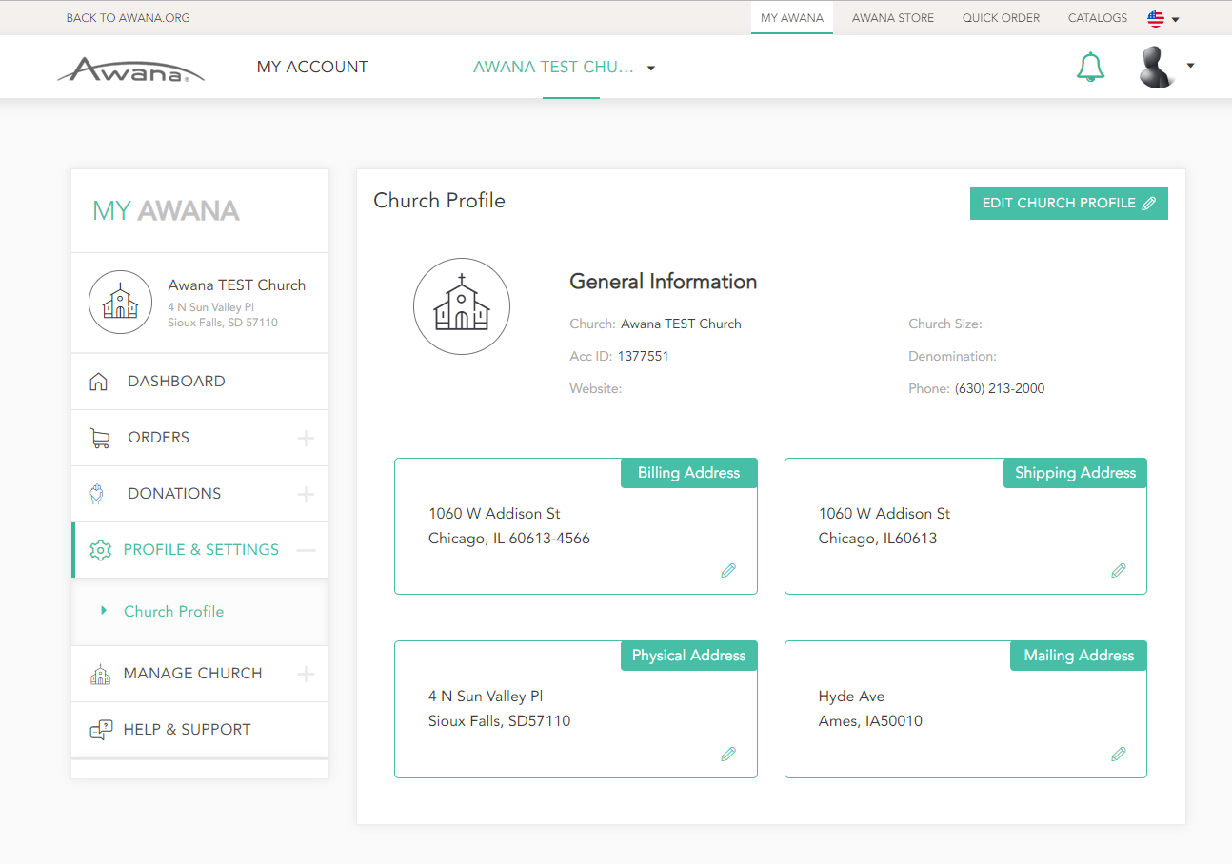
Notes:
The organization owner can edit basic church information like addresses, denomination, etc. on the "Church Profile" page. Again, all of this information connects directly back to Salesforce.

Slide 7
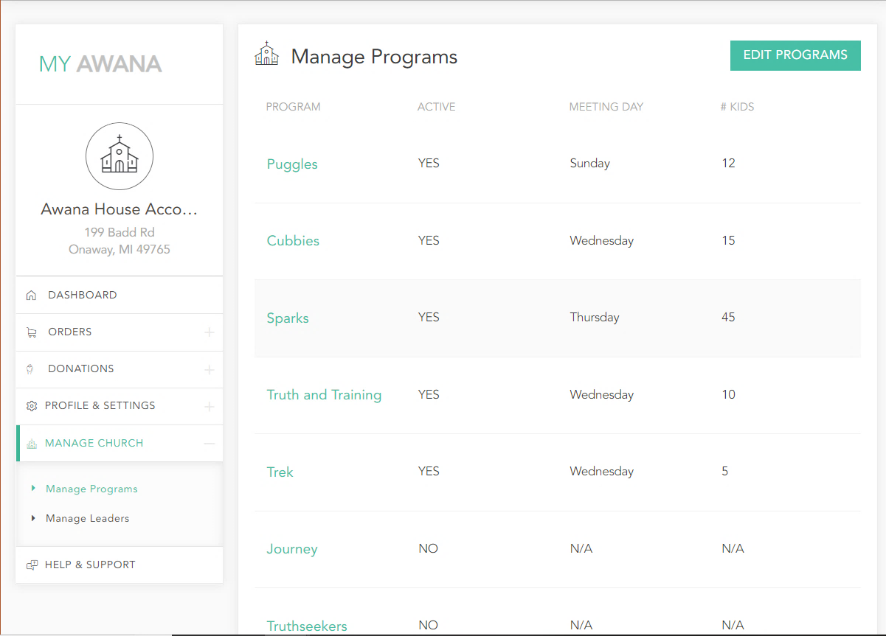
Notes:
The organization owner can also manage active programs their club holds on the "Manage Programs" tab under "Manage Church." Once you mark a program active and choose a meeting day, your changes will be saved to Salesforce, and your church's available programs will now be searchable in the ClubFinder page on the main Awana site.

Slide 8
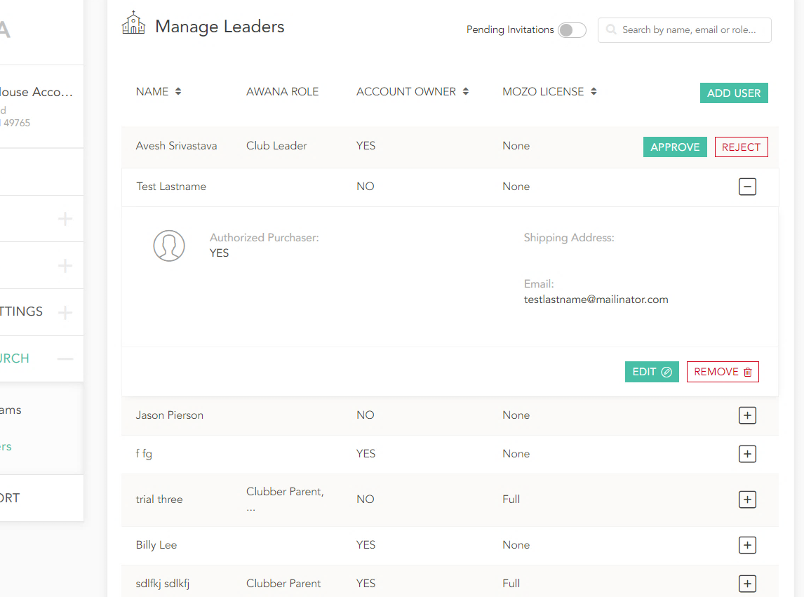
Notes:
The organization owner can also manage active leaders on the "Manage Leaders" tab under "Manage Church." They can do a variety of things, such as accepting or rejecting someone's request to be added or even adding leaders themselves with "Add User", entering a new leader's information to invite them to MyAwana and add them as a leader in your church. They can also edit a leader's role if changed, or remove a user that is no longer active. All of this leader information is connected to Salesforce.

